Slide 1


Granular Permissions
New in SQL Server 2022

Slide 2
Securing SQL Server 2022
SQL Servers is more powerful than ever, with many new features added to SQL Server 2022
This means larger surface area to secure
Principle of Least Privilege (PoLP) has never been more important
There is a need to shift from course-grained to fine-grained permissions that provide options to implement segregation of roles while minimizing overhead

Slide 3
Summary of New Granular Permissions
GRANULAR PERMISSION
SEGREGATION OF ROLE
System Metadata
Security-related Objects
10 new permissions
4 new permissions
5 server-level and 5 database-level
3 server-level and 1 database-level
Extended Events
18 new permissions
9 server-level and 9 database-level
DBA
XE Management
Security
Monitor performance
DMVs, Catalog Views
Manage Extended Events
Manage SQL audits

Slide 4
Granular Permissions for System Metadata
Server-level Scope
Database Level
VIEW SERVER PERFORMANCE STATE
VIEW ANY PERFORMANCE DEFINITION
VIEW SERVER SECURITY STATE
VIEW ANY SECURITY DEFINITION
VIEW ANY CRYPTOGRAPHICALLY SECURED DEFINITION
VIEW DATABASE PERFORMANCE STATE
VIEW PERFORMANCE DEFINITION
VIEW DATABASE SECURITY STATE
VIEW SECURITY DEFINITION
VIEW CRYPTOGRAPHICALLY SECURED DEFINITION
Security-sensitive | Everything Else | Securable
VIEW SERVER SECURITY STATE | VIEW SERVER PERFORMANCE STATE | DMV/DMF
VIEW DATABASE SECURITY STATE | VIEW DATABASE PERFORMANCE STATE | DMV/DMF
VIEW ANY SECURITY DEFINITION | VIEW ANY PERFORMANCE DEFINITION | CATALOG VIEWS
VIEW SECURITY DEFINITION | VIEW PERFORMANCE DEFINITION | CATALOG VIEWS
VIEW ANY CRYPTOGRAPHICALLY SECURED DEFINITION |  | Password_hash (sys.sql_logins), Password_hash (LOGINPROPERTY), crypt_property (sys.key_encryptions)
VIEW CRYPTOGRAPHICALLY SECURED DEFINITION |  | Password_hash (sys.sql_logins), Password_hash (LOGINPROPERTY), crypt_property (sys.key_encryptions)

Slide 5
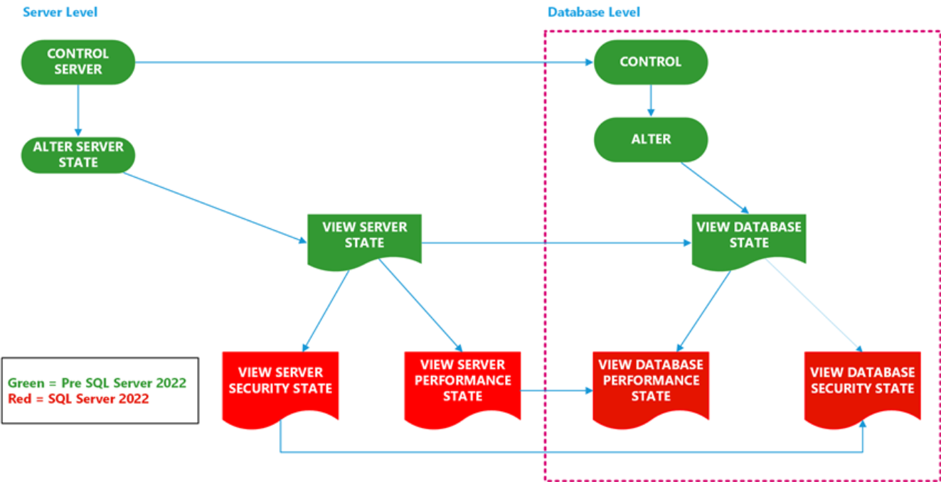
Permissions Hierarchy (DMVs/DMFs)

Slide 6
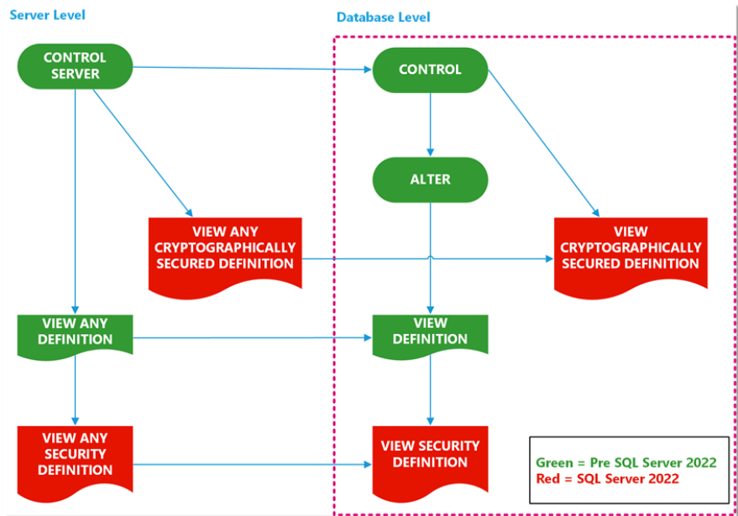
Permissions Hierarchy (Catalog Views)

Slide 7
What else is new?
New Fixed Server Roles!
Role Name | Effective Permission
##MS_DatabaseConnector## | Connect to any database
##MS_ServerStateReader## | View Server State + View Database State
##MS_ServerStateManager## | Same as above + ALTER SERVER STATE
##MS_LoginManager## | CREATE, DELETE, MODIFY logins (cannot grants privs!)
##MS_DatabaseManager## | CREATE + DELETE databases
##MS_DefinitionReader## | Read ALL catalog views (VIEW ANY DEFINITION)
##MS_SecurityDefinitionReader## | Read ALL catalog views (VIEW ANY SECURITY DEFINITION)
##MS_ServerSecurityStateReader## | Read all DMVs (VIEW ANY SERVER/DB SECURITY STATE)
##MS_ServerPerformanceStateReader## | Read all catalog view (PERFORMANCE STATE)
##MS_PerformanceDefinitionReader## | Read all catalog view (PERFORMANCE DEFINITION)
Notes:
There are 10 fixed server-level roles introduced with SQL Server 2022. Some of them covers the granular permissions we just talked about.
MS_Databaseconnector – Before, we must create a user in the database to connect to it but with this role, user can connect to any database without user mapping to the db. (This doesn’t give read access or user can’t see any schema in the db, for that you still must create the user in db and grant read permissions)
MS_Loginmanager – this is like securityadmin role where a user can create/delete and modify logins but without grant privileges. They can’t grant/revoke server/database level permissions as securityadmin did
MS_Databasemanager – This role gives access to create/delete databases. They will become dbowner for the databases they created and can only delete databases they own.
MS_serverstatemanager – same permissions as MS_ServerstateReader+some additional access to cmds like DBCC freeproccache, freesystemcache, sqlperf etc.
MS_serverstatereader – gives access to query all DMVs
MS_serverperformancestatereader – We talked about VIEW SERVER/DATABASE PERFORMANCE STATE in granular permissions right, this role does the same thing. Instead of granting those granular permissions to someone who needs access to performance DMVs, you can simply add them to this server role.
MS_ServerSecuritystatereader – Instead of granting VIEW SERVER/DATABASE SECURITY STATE granular permissions to someone who needs access to security DMVs, you can simply add them to this server role.
MS_DefinitionReader - gives access to query all catalog views
MS_PerformanceDefinitionReader - Instead of granting VIEW ANY PERFORMANCE DEFINITION granular permissions to someone who needs access to performance catalog views, you can simply add them to this server role.
MS_SecurityDefinitionReader - Instead of granting VIEW ANY SECURITY DEFINITION granular permissions to someone who needs access to security catalog views, you can simply add them to this server role.

Slide 8
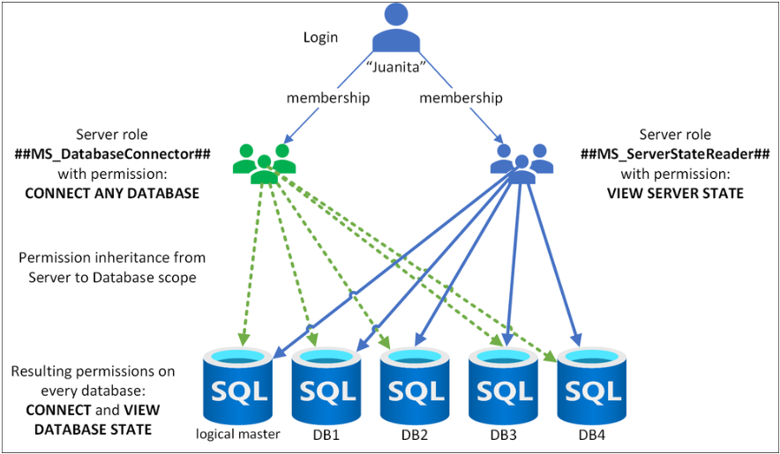
Using The New Server Roles
Notes:
Talking points:
- Compliments the new permissions by providing a way to grant them via roles, which adheres to best-practices and minimize overhead.
##MS_DatabaseConnector##
grants CONNECT ANY DATABASE.
When used with ##MS_ServerStateReader##, effectively grants VIEW SERVER STATE + VIEW DATABASE STATE

Slide 9
Other Granular Permissions (XE and Security)
SQL Ledger
Enable Ledger
Alter Ledger
View Ledger content
Generate Ledger Digest
Extended Events
CREATE ANY EVENT SESSION
Security-related Objects
CREATE LOGIN
DROP ANY EVENT SESSION
ALTER ANY EVENT SESSION OPTION
ALTER ANY EVENT SESSION ADD EVENT
ALTER ANY EVENT SESSION DROP EVENT
ALTER ANY EVENT SESSION ENABLE
ALTER ANY EVENT SESSION DISABLE
ALTER ANY EVENT SESSION ADD TARGET
ALTER ANY EVENT SESSION DROP TARGET
VIEW ANY ERROR LOG
VIEW SERVER SECURITY AUDIT
VIEW DATABASE SECURITY AUDIT
CREATE ANY DATABASE EVENT SESSION
DROP ANY DATABASE EVENT SESSION
ALTER ANY DATABASE EVENT SESSION OPTION
ALTER ANY DATABASE EVENT SESSION ADD EVENT
ALTER ANY DATABASE EVENT SESSION DROP EVENT
ALTER ANY DATABASE EVENT SESSION ENABLE
ALTER ANY DATABASE EVENT SESSION DISABLE
ALTER ANY DATABASE EVENT SESSION ADD TARGET
ALTER ANY DATABASE EVENT SESSION DROP TARGET

Slide 10

Demo

Slide 11

Thank you!

